Slide 1

Chapter 2: OS Structures CSCI 410 Operating Systems

Slide 2
Chapter 2: Operating-System Structures
Operating System Services
System Calls
Types of System Calls
User Operating System Interface
System Programs
Operating System Design and Implementation
Operating System Structure
Virtual Machines

Slide 3
Objectives
To describe the services an operating system provides to users, processes, and other systems
To discuss the various ways of structuring an operating system

Slide 4
Operating System Services
OS provides for users:
User interface
Command-Line (CLI), Graphics User Interface (GUI), Batch
Program execution - load and run program, end execution, (normally or abnormally)
I/O operations - Running program may require I/O

Slide 5
Operating System Services (Cont.)
File-system manipulation - read and write files/directories, create and delete, search, list file info
Communications – Processes may exchange information, on same computer or across network
Use shared memory or message passing
Error detection
in CPU and memory, I/O devices, user program
OS take appropriate action

Slide 6
Operating System Services (Cont.)
OS functions for system
Resource allocation
Accounting - Track resource utilization by user
Protection and security - Concurrent processes should not interfere with each other
Protection - control all access to system resources
Security - user authentication, protect external I/O devices from invalid access

Slide 7
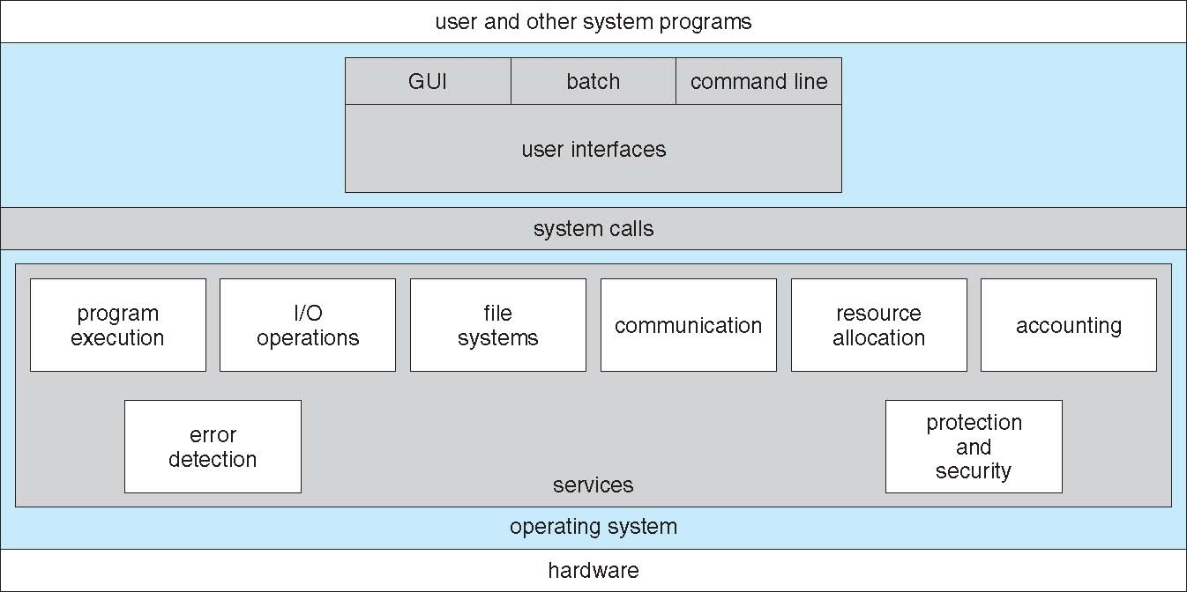
A View of Operating System Services

Slide 8
System Calls
Programming interface to services provided by OS
Typically written in a high-level language (C or C++)
Mostly accessed by programs through Application Program Interface (API)
Common APIs are:
Win32 API for Windows
POSIX API for POSIX-based systems (including virtually all versions of UNIX, Linux, and Mac OS X)
Java API for the Java virtual machine (JVM)

Slide 9
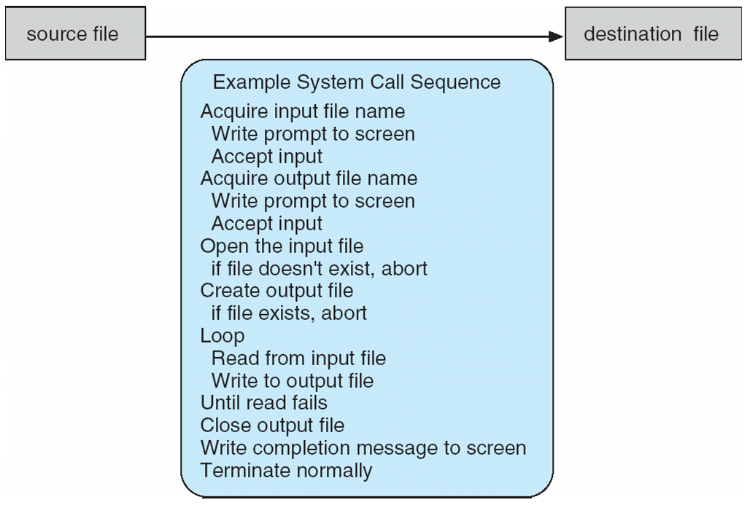
Example of System Calls
System call sequence to copy the contents of one file to another file

Slide 10
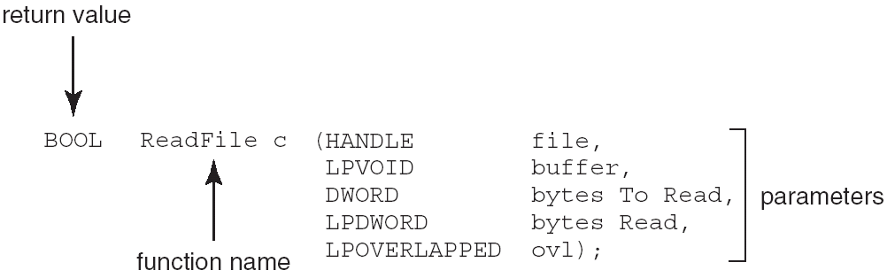
Example of Standard API
Consider the ReadFile() function in the Win32 API
A description of the parameters passed to ReadFile()
HANDLE file—the file to be read
LPVOID buffer—a buffer where the data will be read into and written from
DWORD bytesToRead—the number of bytes to be read into the buffer
LPDWORD bytesRead—the number of bytes read during the last read
LPOVERLAPPED ovl—indicates if overlapped I/O is being used

Slide 11
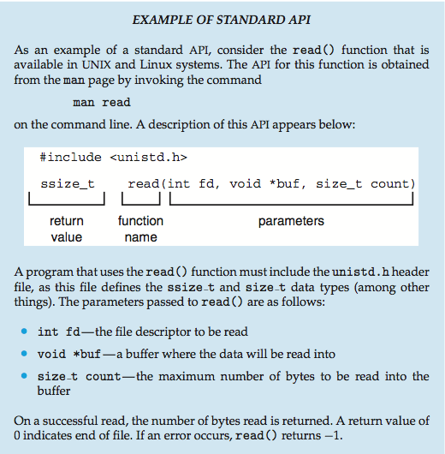
Example of Standard API
Read() function in UNIX API

Slide 12
System Call Implementation
Usually number associated with each system call
System-call interface maintains a table indexed according to these numbers
The system call interface invokes system call in kernel and returns status and return values
The caller doesn’t know how system call is implemented
Use API and understand what OS will do as a result
Most details of OS interface hidden from programmer by API
Managed by run-time support library (set of functions built into libraries included with compiler)

Slide 13
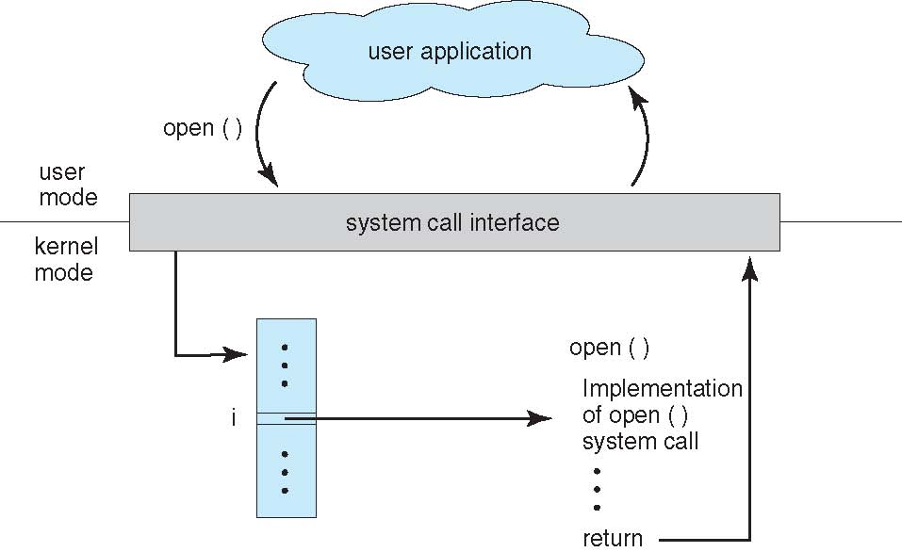
API – System Call – OS Relationship

Slide 14
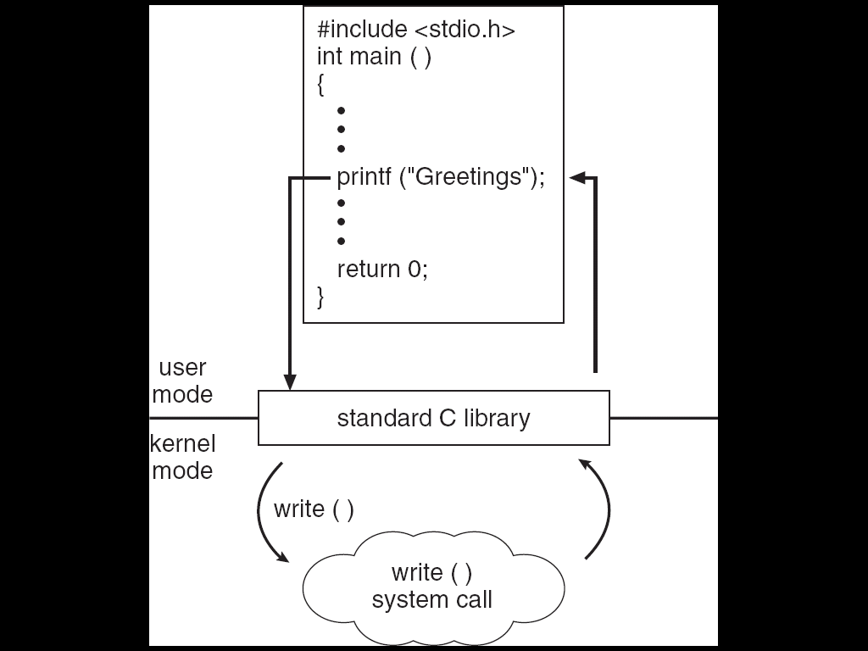
Standard C Library Example
C program invoking printf() library call, which calls write() system call

Slide 15
System Call Parameter Passing
Three methods to pass parameters to OS
Simplest: pass the parameters in registers
May be more parameters than registers
Parameters stored in a block in memory and address of block passed in a register
Linux and Solaris
Parameters placed, or pushed, onto the stack by the program and popped off the stack by OS
Block and stack methods do not limit the number or length of parameters being passed

Slide 16
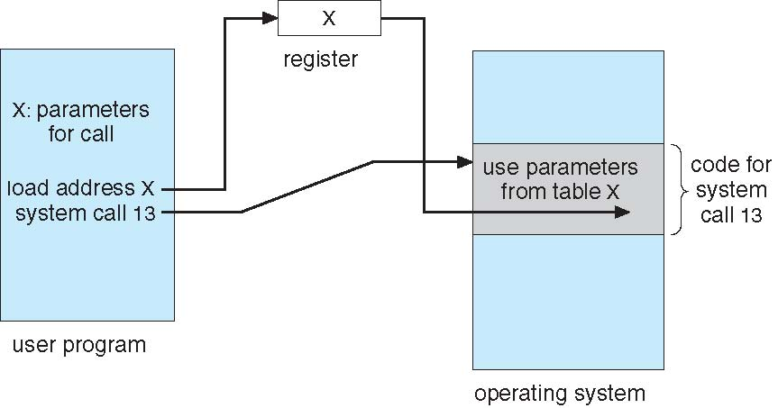
Parameter Passing via Table

Slide 17
Types of System Calls
Process control
end, abort
load, execute
create process, terminate process
get process attributes, set process attributes
wait for time
wait event, signal event
allocate and free memory
File management
create file, delete file
open, close file
read, write, reposition
get and set file attributes

Slide 18
Types of System Calls (Cont.)
Device management
request device, release device
read, write, reposition
get device attributes, set device attributes
logically attach or detach devices
Information maintenance
get time or date, set time or date
get system data, set system data
get and set process, file, or device attributes
Communications
create, delete communication connection
send, receive messages
transfer status information
attach and detach remote devices

Slide 19
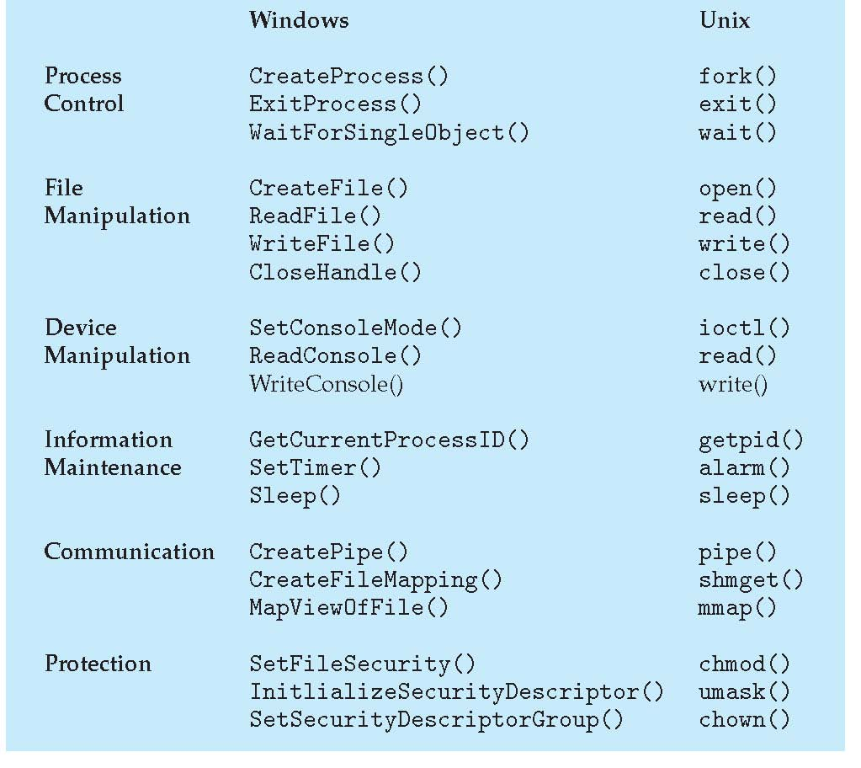
Examples of Windows and Unix System Calls

Slide 20
User Operating System Interface - CLI
Command Line Interface (CLI) allows direct command entry
Sometimes implemented in kernel, sometimes by systems program
Sometimes multiple flavors implemented – shells
Primarily fetches a command from user and executes it
Sometimes commands built-in, sometimes just names of programs
dir, ls part of shell

Slide 21
GUI
User-friendly desktop metaphor interface
Usually mouse, keyboard, and monitor
Icons represent files, programs, actions, etc
Invented at Xerox PARC
Many systems now include both CLI and GUI interfaces
MS Windows and Unix Models are different
Windows is GUI with CLI “command” shell
Unix is CLI with optional GUI interfaces (Java Desktop, KDE)

Slide 22
Example: MS-DOS
Single-tasking
Shell invoked when system booted
Simple method to run program
No process created
Single memory space
Loads program into memory, overwriting all but the kernel
Program exit -> shell reloaded

Slide 23
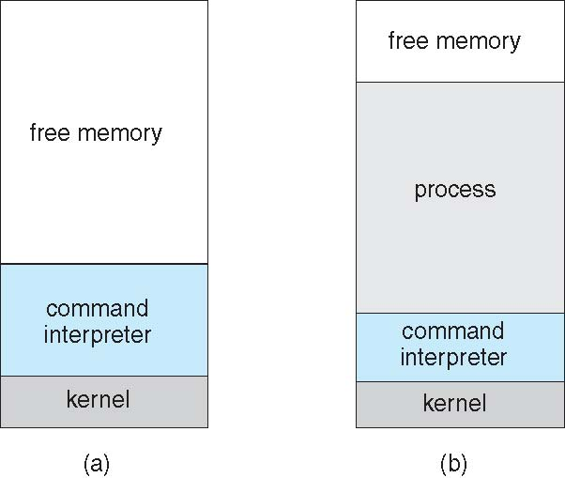
MS-DOS execution
(a) At system startup (b) running a program

Slide 24
Example: FreeBSD
Unix variant
Multitasking
User login -> invoke user’s choice of shell
Shell executes fork() system call to create process
Executes exec() to load program into process
Shell waits for process to terminate or continues with user commands
Process exits with code of 0 – no error or > 0 – error code

Slide 25
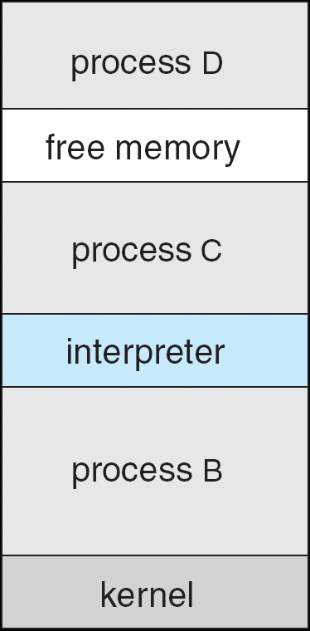
FreeBSD Running Multiple Programs

Slide 26
System Programs
System programs provide environment for program development and execution.
File manipulation
Status information
File modification
Programming language support
Program loading and execution
Communications
Application programs
System status
Most users’ view of the operation system is defined by system programs, not the actual system calls

Slide 27
OS Design and Implementation
Internal structure of Operating Systems can vary widely
Start by defining goals and specifications
Affected by choice of hardware, type of system
User goals and System goals
User goals – OS should be convenient to use, easy to learn, reliable, safe, and fast
System goals – OS should be easy to design, implement, and maintain, as well as flexible, reliable, error-free, and efficient

Slide 28
OS Design & Implementation (Cont.)
Important principle to separate
Policy: What will be done? Mechanism: How to do it?
Separation allows maximum flexibility if policy decisions are to be changed later

Slide 29
Simple Structure
MS-DOS – written to provide the most functionality in the least space
Not divided into modules
Although MS-DOS has some structure, its interfaces and levels of functionality are not well separated

Slide 30
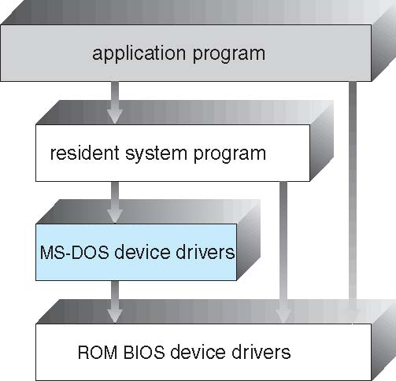
MS-DOS Layer Structure

Slide 31
Layered Approach
OS is divided into a number of layers, each built on top of lower layers.
layer 0 is hardware
layer N is user interface.
Layers use functions and services of only lower-level layers

Slide 32
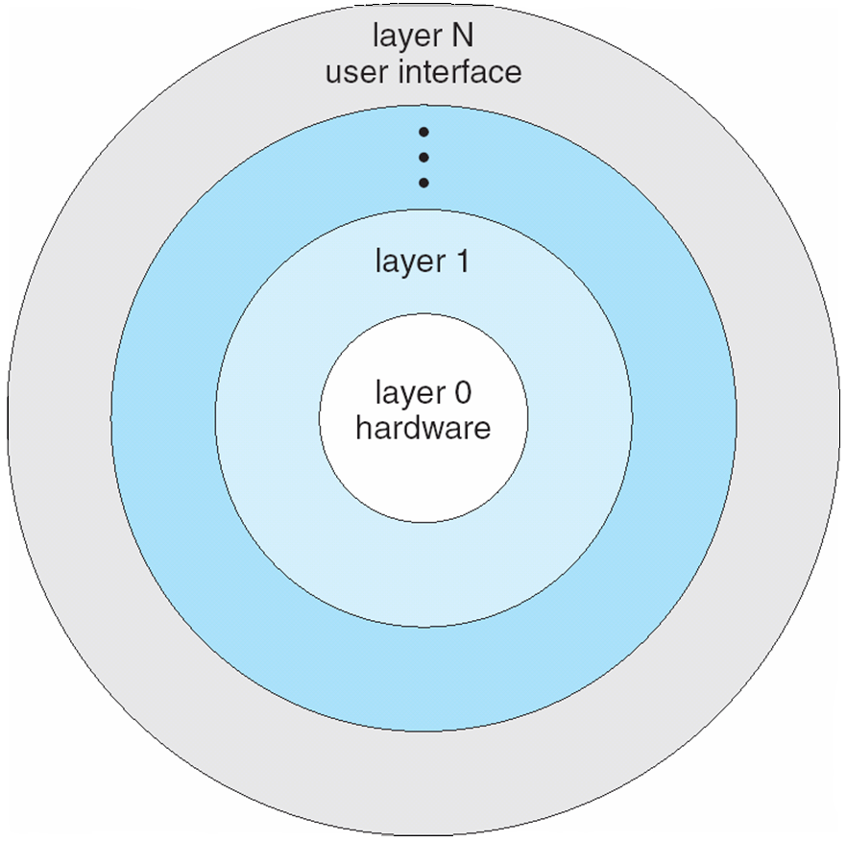
Layered Operating System

Slide 33
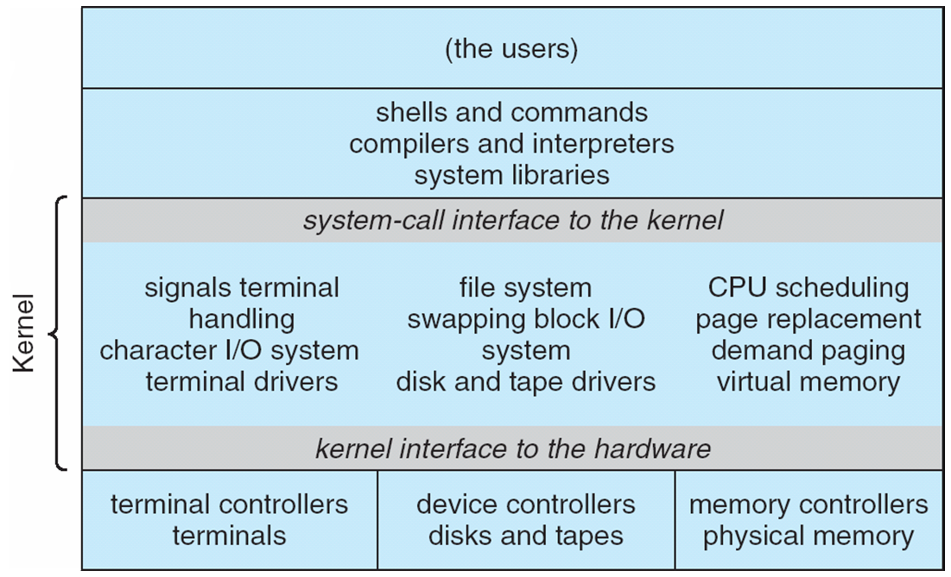
Traditional UNIX System Structure

Slide 34
UNIX
UNIX – originally limited by hardware functionality, so original UNIX had limited structuring
UNIX typically two separable parts
Systems programs
Kernel
Everything below the system-call interface and above the physical hardware
Provides file system, CPU scheduling, memory management, etc.

Slide 35
Microkernel System Structure
Moves functions from kernel into “user” space
Communication takes place between user modules using message passing
Benefits:
Easier to extend a microkernel
Easier to port other architectures
More reliable (less code is running in kernel mode)
More secure
Detriments:
Performance overhead of user space to kernel space communication

Slide 36
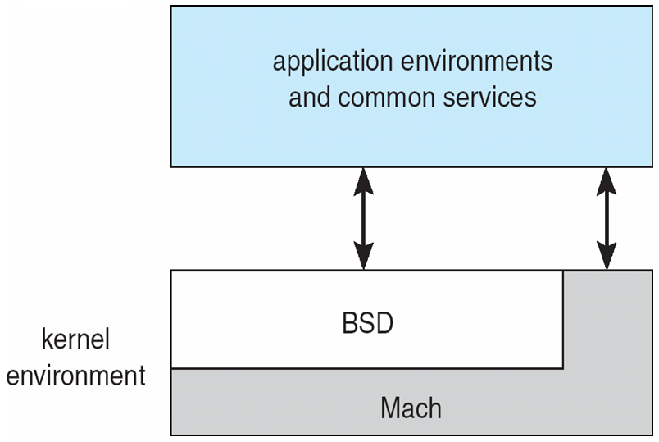
Mac OS X Structure
BSD component maps UNIX sys calls to kernel functions (micro-kernel)
Also allows modules

Slide 37
Modules
Most modern operating systems implement kernel modules
Uses object-oriented approach
Each core component is separate
Each talks to the others over known interfaces
Each is loadable as needed within the kernel
Overall, similar to layers but more flexible

Slide 38
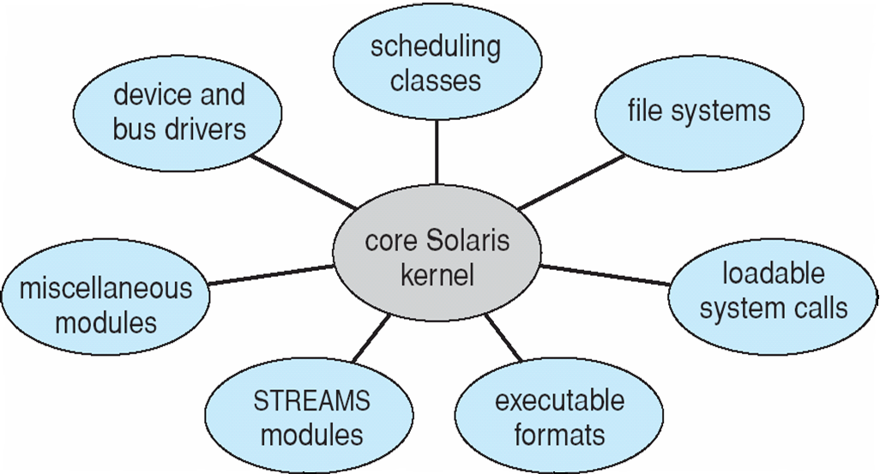
Solaris Modular Approach

Slide 39
Virtual Machines
A virtual machine - a layered approach
Treats hardware and OS kernel as though they were all hardware.
A virtual machine provides an interface identical to the underlying bare hardware.
The operating system host creates illusion that a process has its own processor and (virtual memory).
Each guest provided with a (virtual) copy of underlying computer.

Slide 40
Virtual Machines History
IBM mainframes in 1972
Different OSs can share hardware
Protected from each other
Sharing of files can be permitted
Communicate through networking
Good for development, testing
Consolidation of servers

Slide 41
Virtual Machines History
Open Virtualization Format (OVF)
Standard format of virtual machines
Allows a VM to run on different host platforms
OVF package is multiple files in one directory
OVF v1.0.0 approved in 2008
V1.1.0 in 2010
OVF 2.0 released in 2013
Supported by VirtualBox, some VMware (since 2007) support

Slide 42
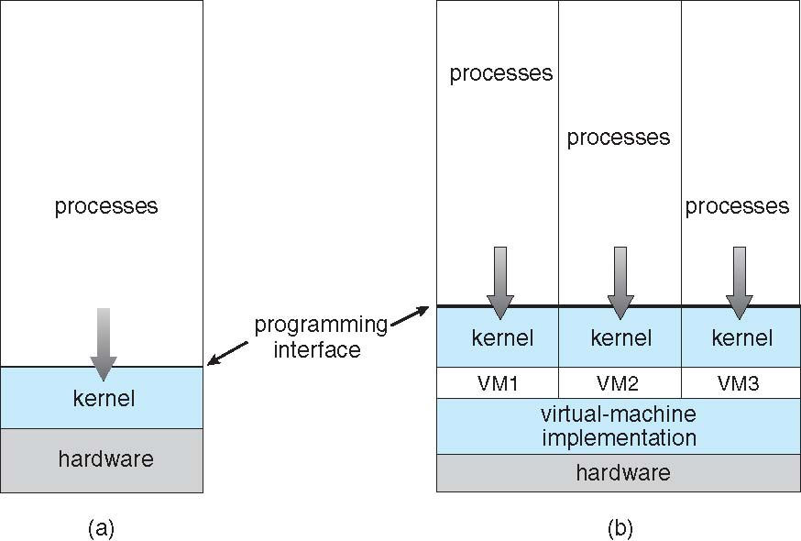
Virtual Machines (Cont.)
(a) Nonvirtual machine (b) virtual machine

Slide 43
Para-virtualization
Presents guest with system similar but not identical to hardware
Guest must be modified to run on paravirtualized hardware
Guest can be an OS, or in the case of Solaris 10 applications running in containers

Slide 44
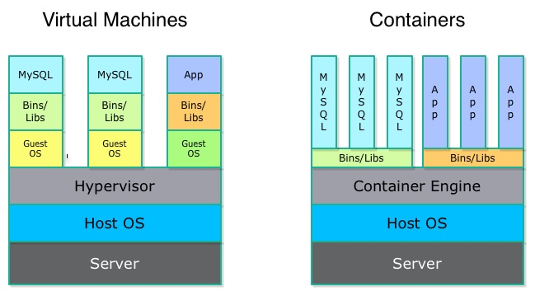
Container vs. VM

Slide 45
Virtualization Implementation
Difficult to implement – must provide an exact duplicate of some machine
Creates virtual user mode and virtual kernel mode
Slower than real machine
Hardware support needed (AMD-V, VT-x)
More support-> better virtualization
i.e. AMD provides “host” and “guest” modes
Most include virtual paging, networking … support

Slide 46
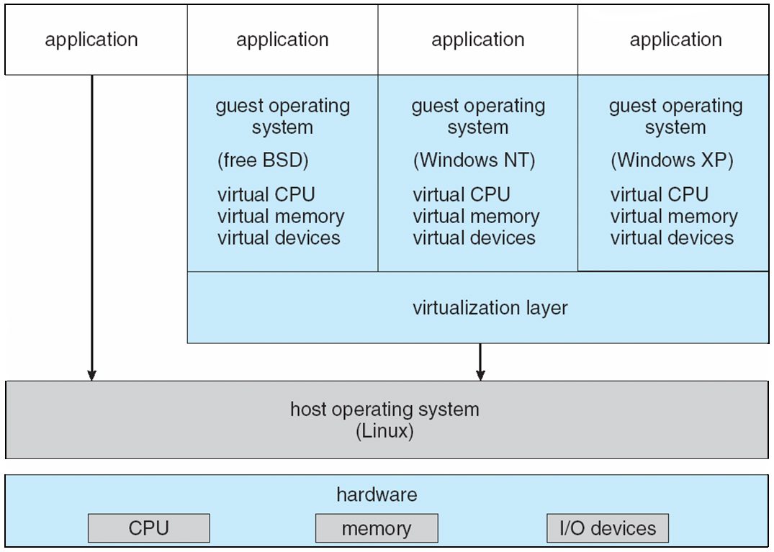
VMware Architecture

Slide 47
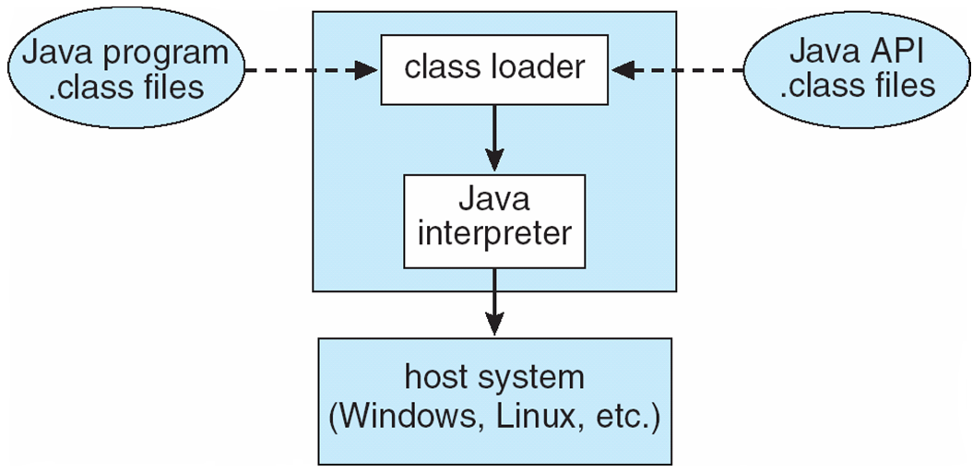
The Java Virtual Machine

Slide 48
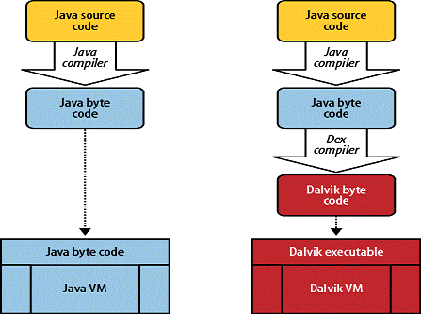
Android
Prior to 5.0

Slide 49
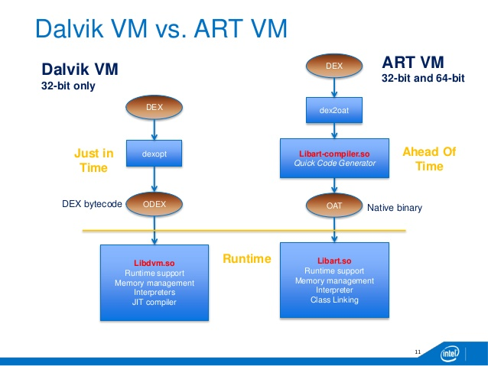
More Android
Android 5.0 and later

Slide 50
End of Chapter 2

